Slide 1
Operation manual (2)
Dr Arash kazemi veisari
EUS fellow

Slide 2
Doppler
The Doppler effect is used in ultrasound applications to identify objects that are in motion relative to the transducer. In biologic applications the reflective objects in motion are red blood cells.

Slide 3
The fundamental basis for the Doppler effect in ultrasound is that an object in motion relative to the source transducer will reflect an ultrasound wave at a different frequency relative to the frequency transmitted by the source transducer; this is termed the Doppler shift.

Slide 4
The received sound frequency can be higher or lower than the transmitted sound frequency, depending on whether the RBCs are moving toward the transducer (higher) or away from it (lower)

Slide 5
f D = 2 v f t cos θ c
f _{D} is the Doppler shift frequency, which is the difference between the transmitted and reflected frequencies; v is the velocity of the object in motion (red blood cells); f _{t} is the transmitted frequency; θ is the angle at which the object in motion is traveling relative to the direction of the source beam and c is the speed of sound in tissue (1540 m/s).

Slide 6
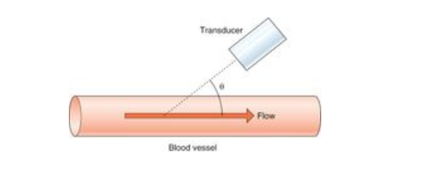

Slide 7
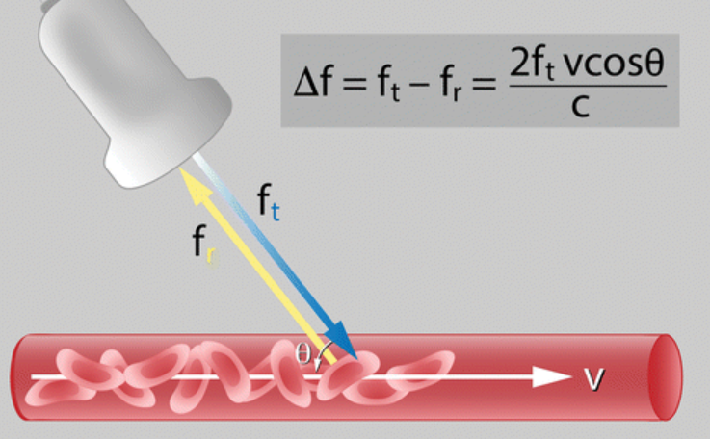

Slide 8
Therefore interrogation of a blood vessel should be at an angle other than 90 degrees, with the greatest Doppler shift detected when the object in motion is moving along the axis of the transmitted ultrasound wave.(less than 60 degree is better).

Slide 9
The different implementations of Doppler ultrasound include continuous-wave, pulsed-wave, color, and power Doppler.

Slide 10
Pulsed-Wave Doppler
Pulsed-wave Doppler was developed to obtain depth information regarding the location of the motion causing the Doppler shift.

Slide 11
The output from pulsed-wave Doppler is usually in the form of an audible signal. The combination of pulsed-wave Doppler with B-mode imaging, termed duplex scanning, allows the operator to interrogate a specific location within a B-mode image.

Slide 12
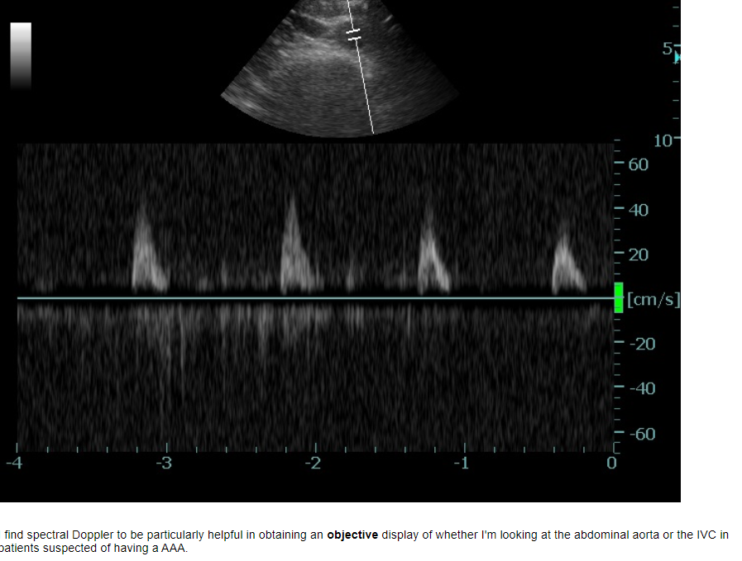

Slide 13
Continuous-wave Doppler ultrasound
Continuous-wave Doppler utilizes continuous transmission and reception of ultrasound waves. This is accomplished by two dedicated transducer elements: one that solely sends a signal and another that only receives.
CW Doppler does not permit us to determine where the wave is reflected. It is not site specific.

Slide 14
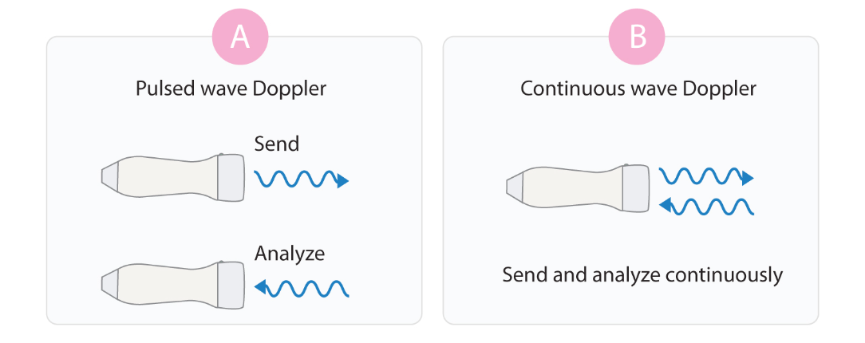

Slide 15
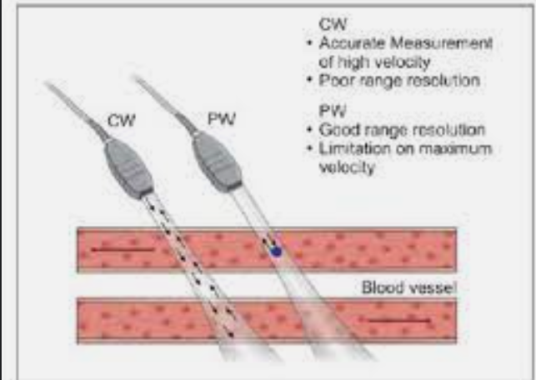

Slide 16
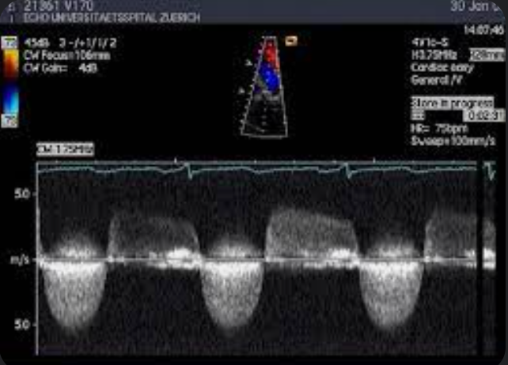

Slide 17
We only know that the depicted velocity curve stems from a reflector somewhere along the path of the ultrasound beam, which is known as the CW Doppler line. The advantage of CW Doppler is its ability to measure high velocities, which are frequently observed in pathologies of the heart (e.g. aortic stenosis).

Slide 18
Thus pulsed-wave Doppler has signal aliasing at high frequencies but has depth acuity, whereas continuous-wave Doppler has no signal aliasing but does have depth ambiguity. Hence, these two Doppler modes are complementary, and when they are used together, each can supply the information missing from the other technique.

Slide 19
Color Doppler
Color Doppler is a method of visually detecting motion or blood flow .
a larger region can be interrogated, and detected blood flow is assigned a color, typically blue or red, depending on whether the flow is moving toward or away from the transducer.

Slide 20
The benefit of color Doppler is that information on the direction and relative velocity of blood flow can be obtained. Color Doppler is limited by its dependence on the relative angle of the transducer to the blood flow.

Slide 21
What is the difference between Color wave and pulse wave Doppler?
Pulsed wave Doppler, however, is limited to the interrogation of flow velocity and direction along a single line at a certain depth (defined by the sample volume or gate)
Color flow Doppler simultaneously interrogates multiple sample volumes (with each pixel representing a sample volume) along an array of scan lines.

Slide 22
Another important point in measuring the velocity is that, in the presence of a turbulent flow, the measured velocity by PW Doppler cannot be used to estimate the flow because of aliasing that occurs with higher velocitie. Therefore, the operator should assess the flow by color Doppler first to ensure that the flow is laminar before attempting to obtain the velocity by PW Doppler.

Slide 23
Power Doppler
Power Doppler is the most sensitive Doppler method for detecting blood flow and should be used to identify blood vessels when information on direction of flow and velocity is not needed.

Slide 24
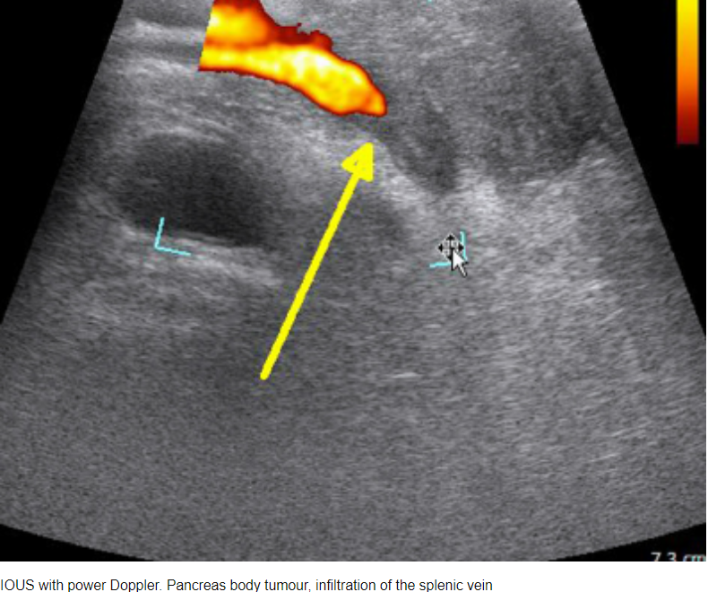

Slide 25
instead of estimating the frequency shift as in color Doppler, the integral of the power spectrum of the Doppler signal is estimated.

Slide 26
OPTIMIZATION OF COLOR DOPPLER IMAGING
Activate the color‑sampling box
In this box, the Doppler information is superimposed over the gray-scale B-mode image as several thousand color pixels.

Slide 27
Choose the most appropriate color Doppler mode
Most US machines used for EUS provide the opportunity to choose among two or more Doppler modes:
1. traditional color Doppler imaging (CDI)
2.color Doppler velocity (CDV)
3.and color Doppler energy (CDE; power Doppler; angio mode).

Slide 28
CDI provides information about the presence or absence of flow, mean flow velocity, and direction of flow within the selected color box.
Flow-related information is superimposed on a gray-scale US image; this allows the examiner to know where the flow signals originate.
Therefore, CDI has dual capability: for evaluation of tissue characteristics (on the gray-scale image) and assessment of vascular hemodynamics.

Slide 29
Note that no absolute value of velocity can be determined from color Doppler images.

Slide 30
CDV, all the three basic flow information are displayed, namely flow direction (red: to the transducer; blue: away from the transducer), flow velocity (color tone or color brightness), and distribution of velocities within the vessel (represented by different colors within the vessel).

Slide 31
Turbulent (nonlaminar) blood flow is represented by the addition of green hues to the other colors (a mosaic pattern).
Aliased velocities shift the color from red to blue or vice versa (color reversal). A mosaic pattern and color reversal often coexist because high velocities are usually associated with turbulent flow.

Slide 32
CDE,power Doppler, angio mode
With CDE, the information is restricted to flow intensity (one color, with brightness related to flow intensity.

Slide 33
Compared to CDV, CDE is more sensitive and less dependent from Doppler angle.
Another advantage of PDI is that it can enable a global assessment of organ and tissue perfusion . Conventional PDI does not yield information about flow direction.

Slide 34
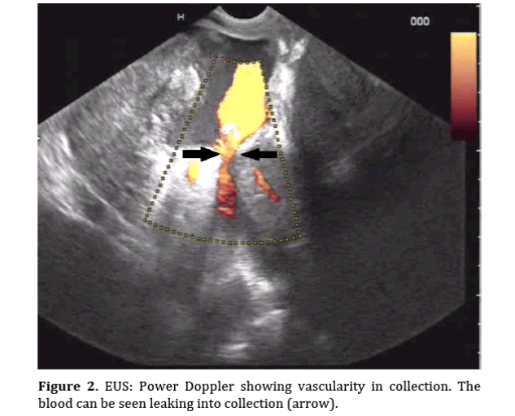

Slide 35
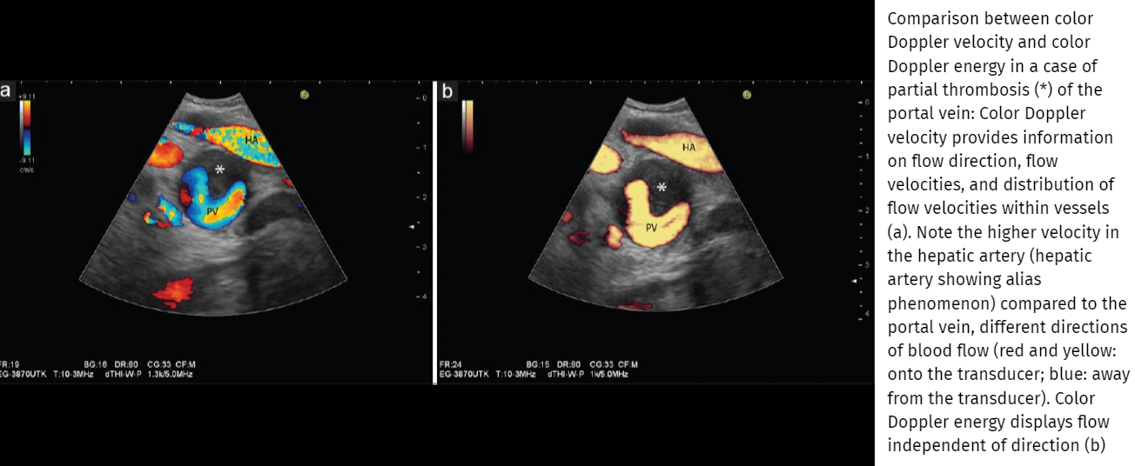

Slide 36
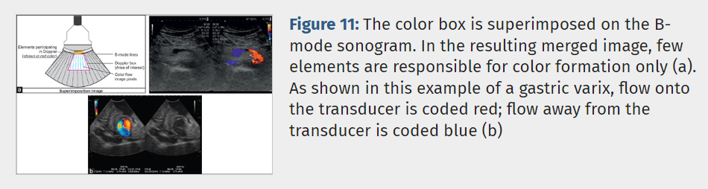

Slide 37
adjustment of Doppler controls
examiner to adjust primary and secondary Doppler controls.
Primary Doppler controls comprise the color
1.box size
2.color box
3.angle
4.color gain
5.pulse repetition frequency (PRF)
5.“invert” control.

Slide 38
Secondary Doppler controls entail the
1.wall filter
2.Doppler frequency
3.write priority.

Slide 39
Adjust the color box size
The controls on the dashboard help the user change the shape and position of the color box .

Slide 40
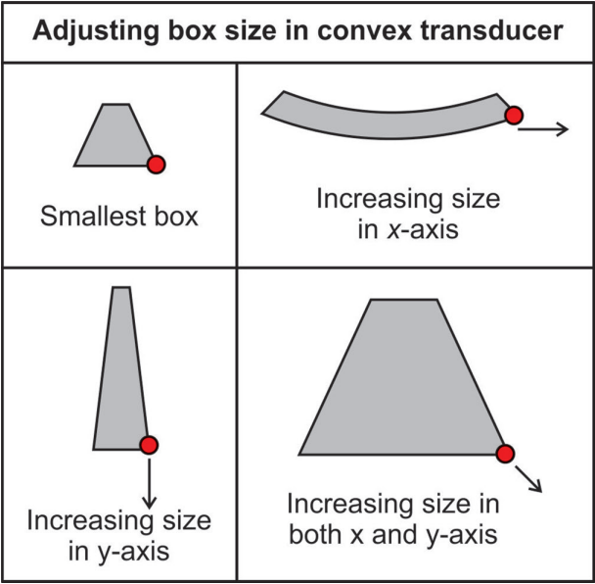

Slide 41
Adjust the Doppler insonation angle:
With radial and curvilinear transducers used with EUS, the Doppler angle may be adjusted only by angulating the tip of the scope.
If this maneuver fails to improve the orientation, technical shifting of the angle of insonation, image steering) might help.

Slide 42
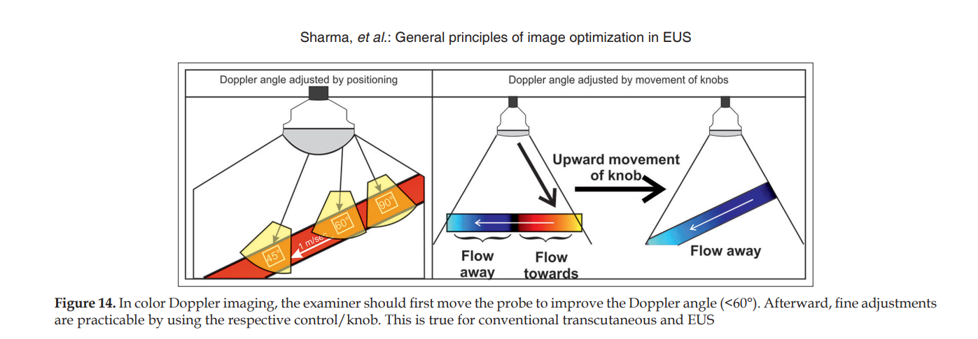

Slide 43
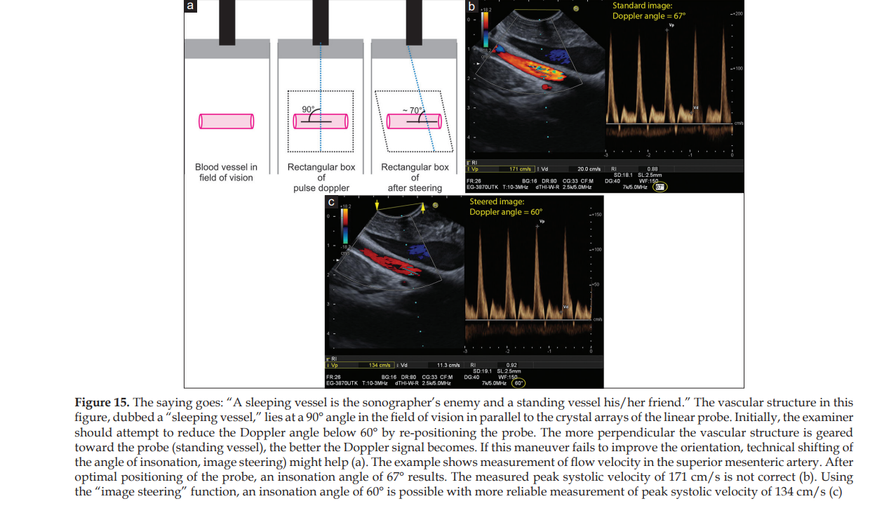

Slide 44
adjust the velocity scale/pulse repetition frequency
After activating the color-sampling box, a “color bar” or “color map” appears on the side of the screen, which is divided into two equal parts by a black bar that marks the baseline or point of zero flow on the Doppler spectrum.

Slide 45
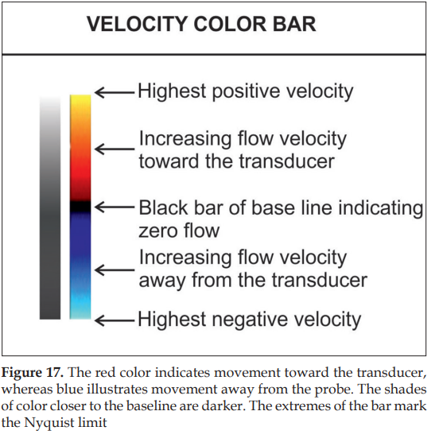

Slide 46
The extremes of the color bar are marked by the maximum (positive) and minimum (negative) velocity in centimeter per second.
This value indicates the highest measurable limit for a given Doppler signal shift and is known as the Nyquist limit (half the Doppler PRF).

Slide 47
The Nyquist limit represents the maximum Doppler shift frequency that can be correctly measured without resulting in aliasing in color or pulsed wave ultrasound.

Slide 48
Physics
The Nyquist limit always equals Pulse Repetition Frequency (PRF)/2. The US machine can display the Nyquist limit either as the maximum measurable blood flow velocity, or in kHz, the latter representing the maximum measurable Doppler shift.
If the blood flow velocity exceeds this limit the device will incorrectly register the direction and velocity of the flow, resulting in color or spectral Doppler aliasing artifact.

Slide 49
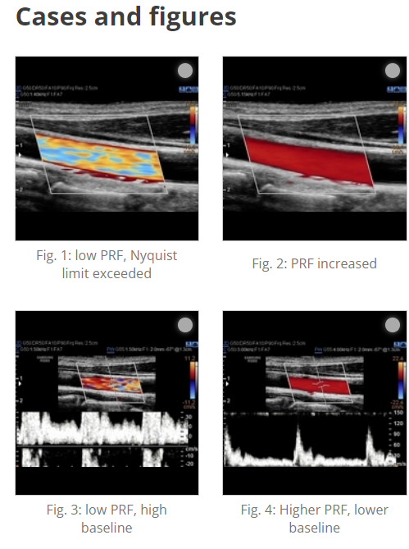

Slide 50
Aliasing is a phenomenon inherent to Doppler modalities which utilize intermittent sampling in which an insufficient sampling rate results in an inability to record direction and velocity accurately.

Slide 51
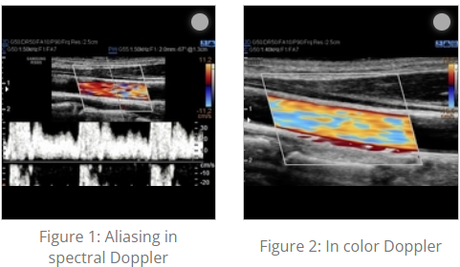

Slide 52
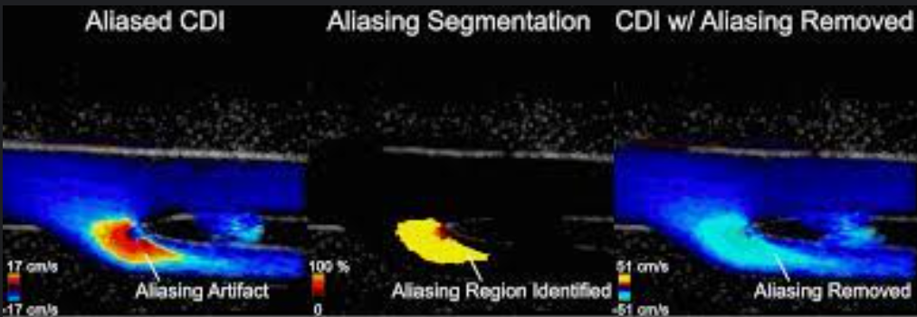

Slide 53
Other potential causative factors include:
use of higher frequency transducers
inappropriate angle of insonation
large sampling volume

Slide 54
In general, there are two indications for CDI: (a) to display the direction and perfusion of a large vessel and (b) to analyze the perfusion of a certain ROI. In EUS, b) is often the indication (solid tumor vascularization). Thus, PRF is mostly optimized to analyze the micro vascularization or maybe perfusion of a ROI.
Thus, it is of importance to lower the frequency so that it does enable the investigator not to fail to display even small vessels in a certain ROI

Slide 55
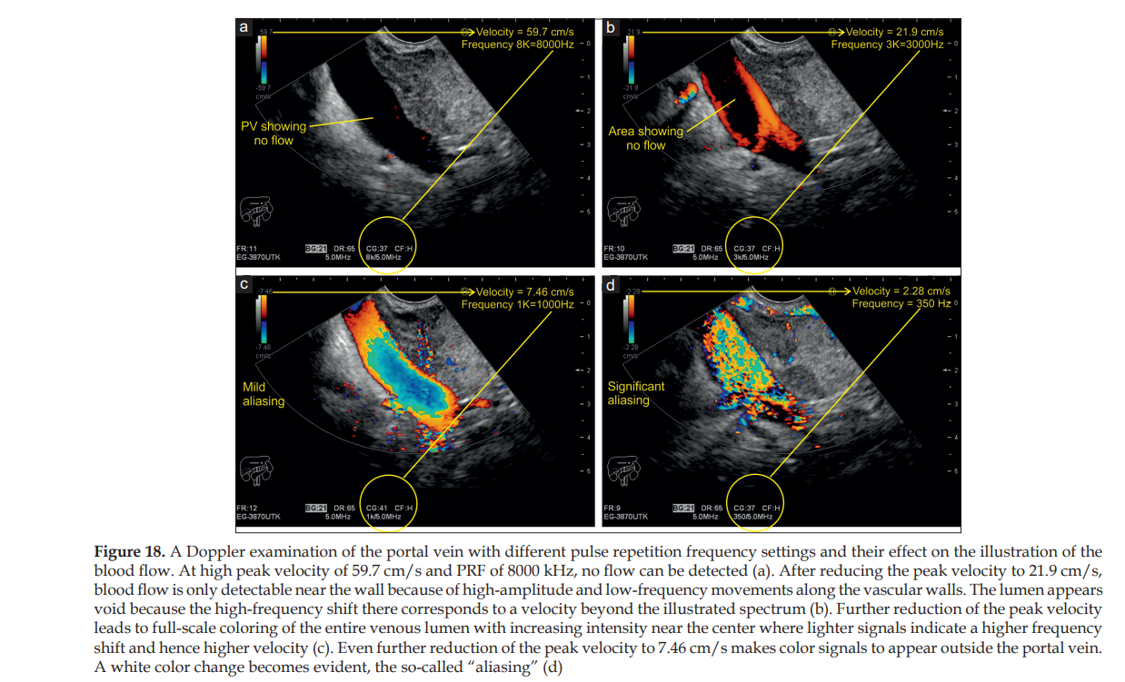

Slide 56
Velocity and PRF are parameters for measuring Doppler shifts. Velocity is expressed as centimeter per second and PRF is measured in kilohertz (kHz). Both are directly proportional, that is, increasing the velocity scale increases the PRF and vice versa.

Slide 57
The examiner can manually adjust the range of the scale relative to the vascular structure of interest.
In general, measurements in arteries require a higher velocity scale, whereas for venous blood flow examinations, a lower velocity spectrum is recommended.

Slide 58
Scales with a wider range cannot portray the velocity in veins adequately, whereas the use of low-range scales for intra-arterial measurements results in “aliasing,” which happens when the measured frequency shift exceeds half the PRF of the peak velocity on the scale.

Slide 59
Adjust the color gain:
adjust the color gain Initially, the operator should optimize the insonation angle, followed by adjusting the PRF.
then the gain will be increased excessively for a technical phenomenon, called “color bleed” or “blooming,” which refers to a flurry of color pixels outside the vascular lumen. This extraluminal signal is called noise.

Slide 60
Then, the gain is subsequently decreased until the noise disappears, but the lumen should then still be completely filled with color signals.

Slide 61
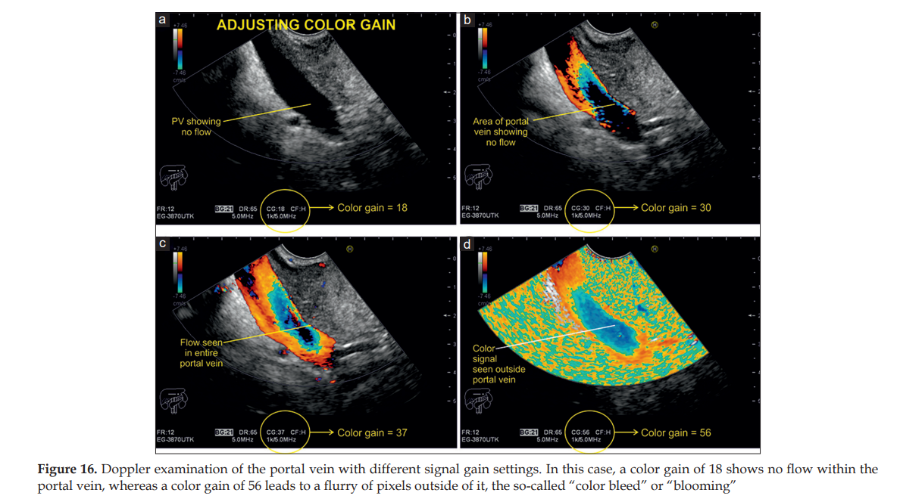

Slide 62
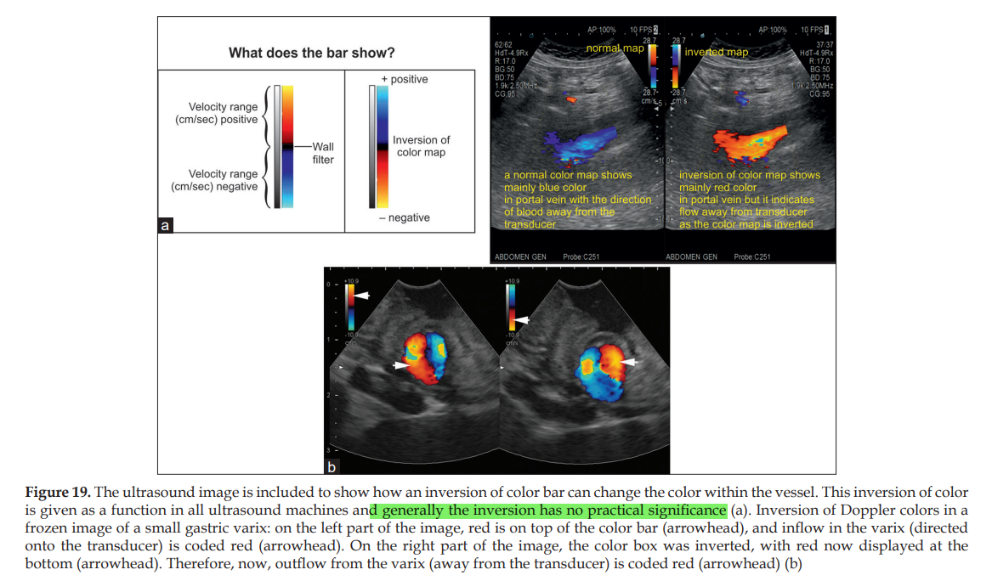
Apply invert control

Slide 63
ADJUSTMENT OF SECONDARY COLOR DOPPLER CONTROLS
Adjust the color Doppler wall filter
Blood flow stimulates the vascular walls and the surrounding tissue. Doppler echoes are generated both by interference with the moving red blood cells (RBCs) and by oscillation of the vascular walls and the surrounding tissue (pulsations).

Slide 64
In comparison, Doppler echoes emitted by oscillating vascular walls and tissue are very strong (with an amplitude ~100 times stronger than the signal of the moving RBCs) but produce low‑frequency signals.

Slide 65
Wall filters eliminate the interfering high-amplitude and low-frequency signals from these sources.
this function should be applied with caution, especially in low‑flow scenarios (e.g., examinations of the portal vein [PV] in patients with portal hypertension).

Slide 66
Higher settings of wall filters are usually chosen for arterial examinations and lower settings for venous measurements.
Typical Wall filter setting are <25-50 Hz for venous flow and <50 _100 for arterial flow .

Slide 67
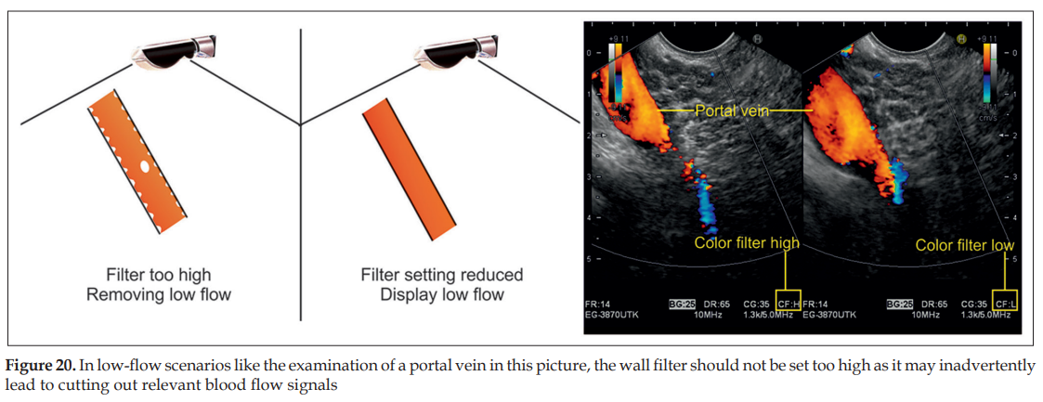

Slide 68
Adjust the Doppler frequency
The Doppler frequency shift is proportional to the Doppler transmission frequency. The higher the transmission frequency, the higher the Doppler shift becomes.

Slide 69
In general, in color mode, it is recommended to start the examination with the lowest frequency that the transducer provides.
Whenever the flow velocity is low, higher frequencies can be used to improve the sensitivity of flow detection.

Slide 70
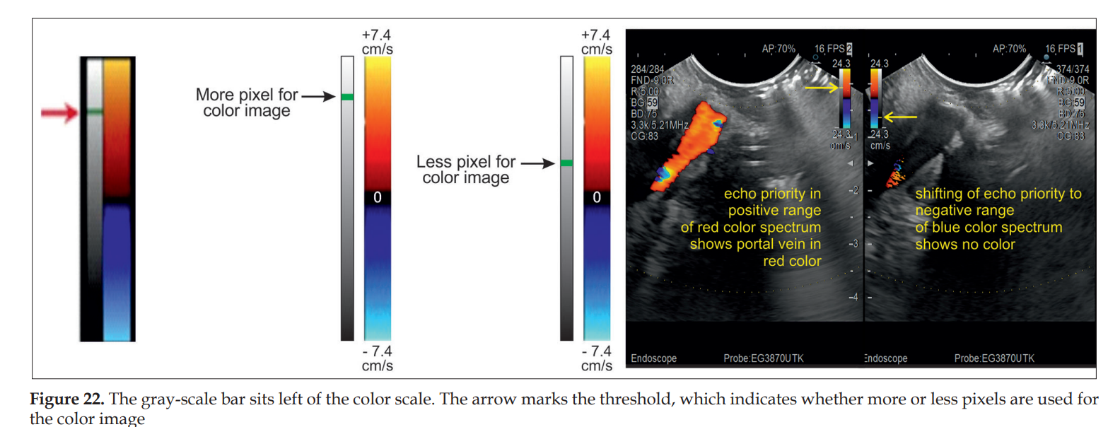
Adjust the “write priority” function

Slide 71
OPTIMIZATION OF SPECTRAL DOPPLER IMAGING
The combination of the two imaging modalities, “pulsed‑wave (PW) Doppler” (or spectral Doppler) and real-time B-mode imaging, is called “duplex Doppler imaging.”

Slide 72
Concurrent color Doppler imaging coupled with the duplex Doppler mode is referred to as “triplex imaging.”

Slide 73
Activate the axis
By pressing the “PW” (pulsed wave) Doppler button, a dotted line that represents the insonation axis and two bars marking the so‑called “SV” (or “gate”) appear on the screen.

Slide 74
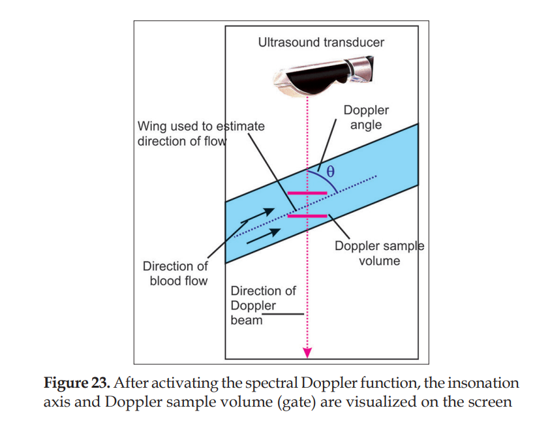

Slide 75
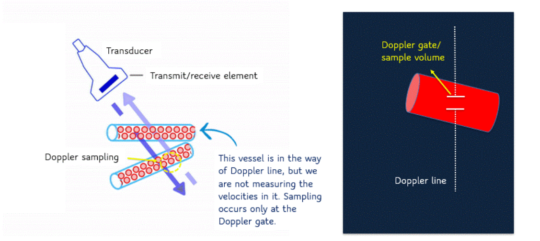

Slide 76
Position the depth of the gate
The examiner can shift the insonation axis and the gate with the trackball to the area of interest. The gate depth eventually determines the PRF and velocity scale. As the imaging depth increases, the PRF decreases.

Slide 77
Vascular structures in deeper parts of the sonogram can only be assessed at lower PRF and velocity range.

Slide 78
Adjust the size of the gate/sample volume
The Doppler SV refers to the frequency spectrum from a specific location. The sample size or gate should fill the vessel lumen without touching its walls (~2/3rd of the vessel diameter). Making the SV wider captures more slow-flow components near the walls, thus producing a noisy frequency shift spectrum and blurring of the spectral Doppler graph.

Slide 79
Adjust the Doppler angle
Velocity measurements are only reliable if the Doppler angle
is <60°. Adjustment is necessary if the Doppler angle
is between 30° and 60° .

Slide 80
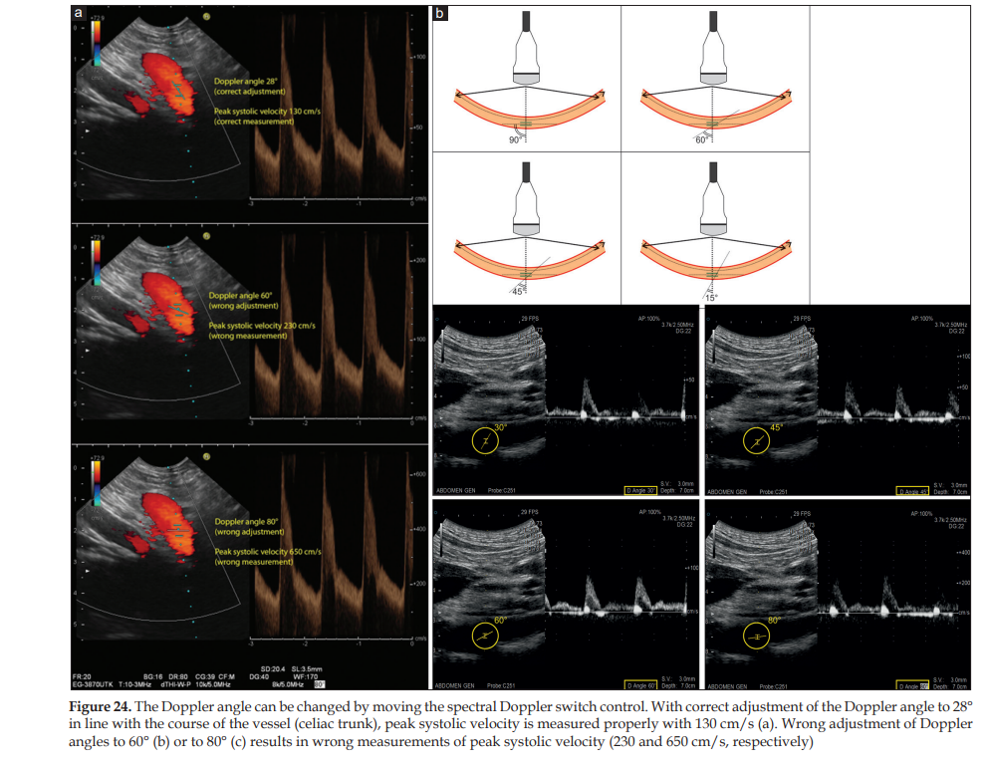
Adjust the Doppler angle

Slide 81
Adjust the gain
The user should optimize the insonation angle first, followed by adjustment of the PRF and thirdly the Doppler gain

Slide 82
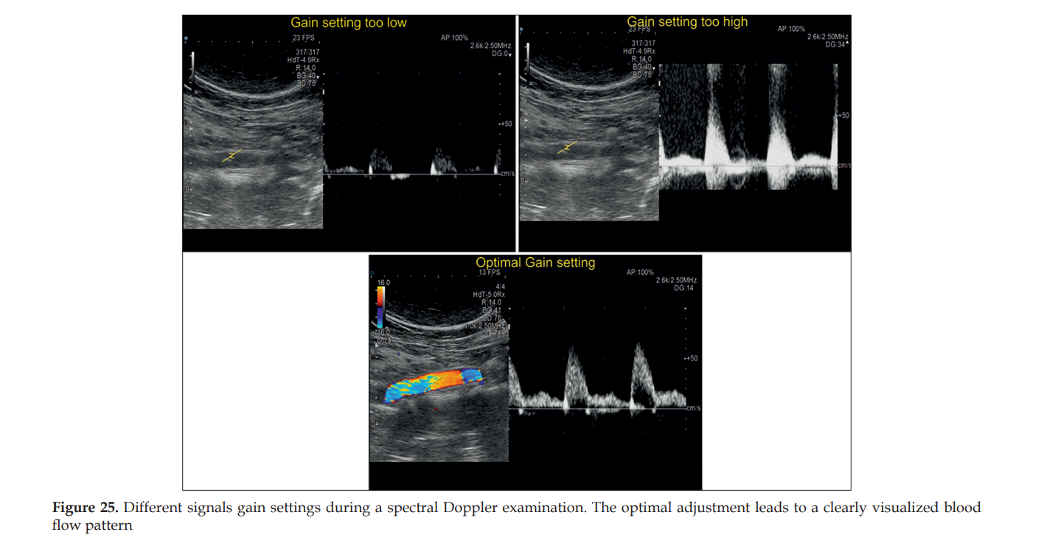

Slide 83
Spectral Doppler permits graphic display of velocities over time. Velocity curves provide information about absolute velocities and the direction of blood flow as well as how velocity changes in a certain region (pulsed-wave Doppler) or along a certain Doppler line (continuous-wave Doppler).

Slide 84
Special situations during Doppler imaging
Adjustments for color Doppler in the case of too much color or high flow:
1. Decrease color gain
2. Increase color velocity scale.

Slide 85
Adjustments for color Doppler in the case of lacking color or low flow:
1. Highest gain without background noise (increase color, power, and pulsed Doppler gain)
2. Decrease color velocity scale/PRF
3. Optimize Doppler angle (below 60°)
4. Increase the range of Doppler shift in one direction by shifting the baseline

Slide 86
5. Downsize the color box
6. Choose the wall filter with the lowest sensitivity acceptable
7. Try higher basic frequency for color Doppler
8. Set color priority to “high”
9. Set the focus at the level of interest
10.Increase the persistence
11.Increase the SV gate.

